Slide 1
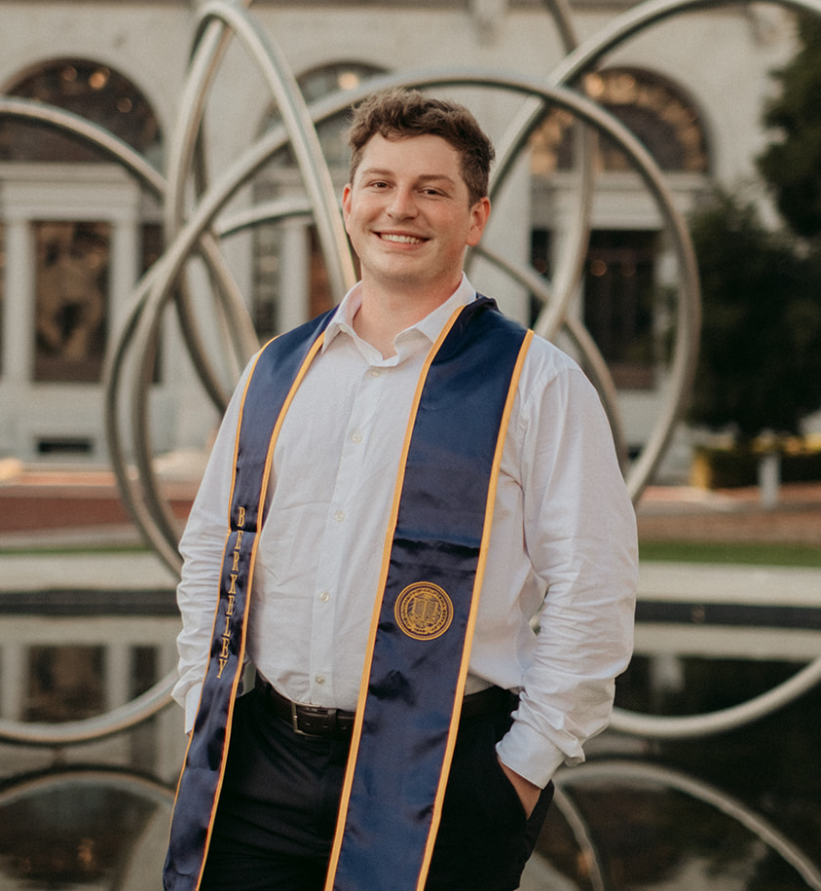
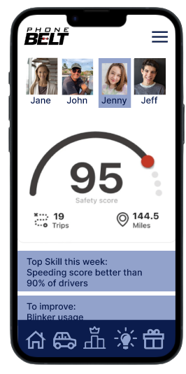
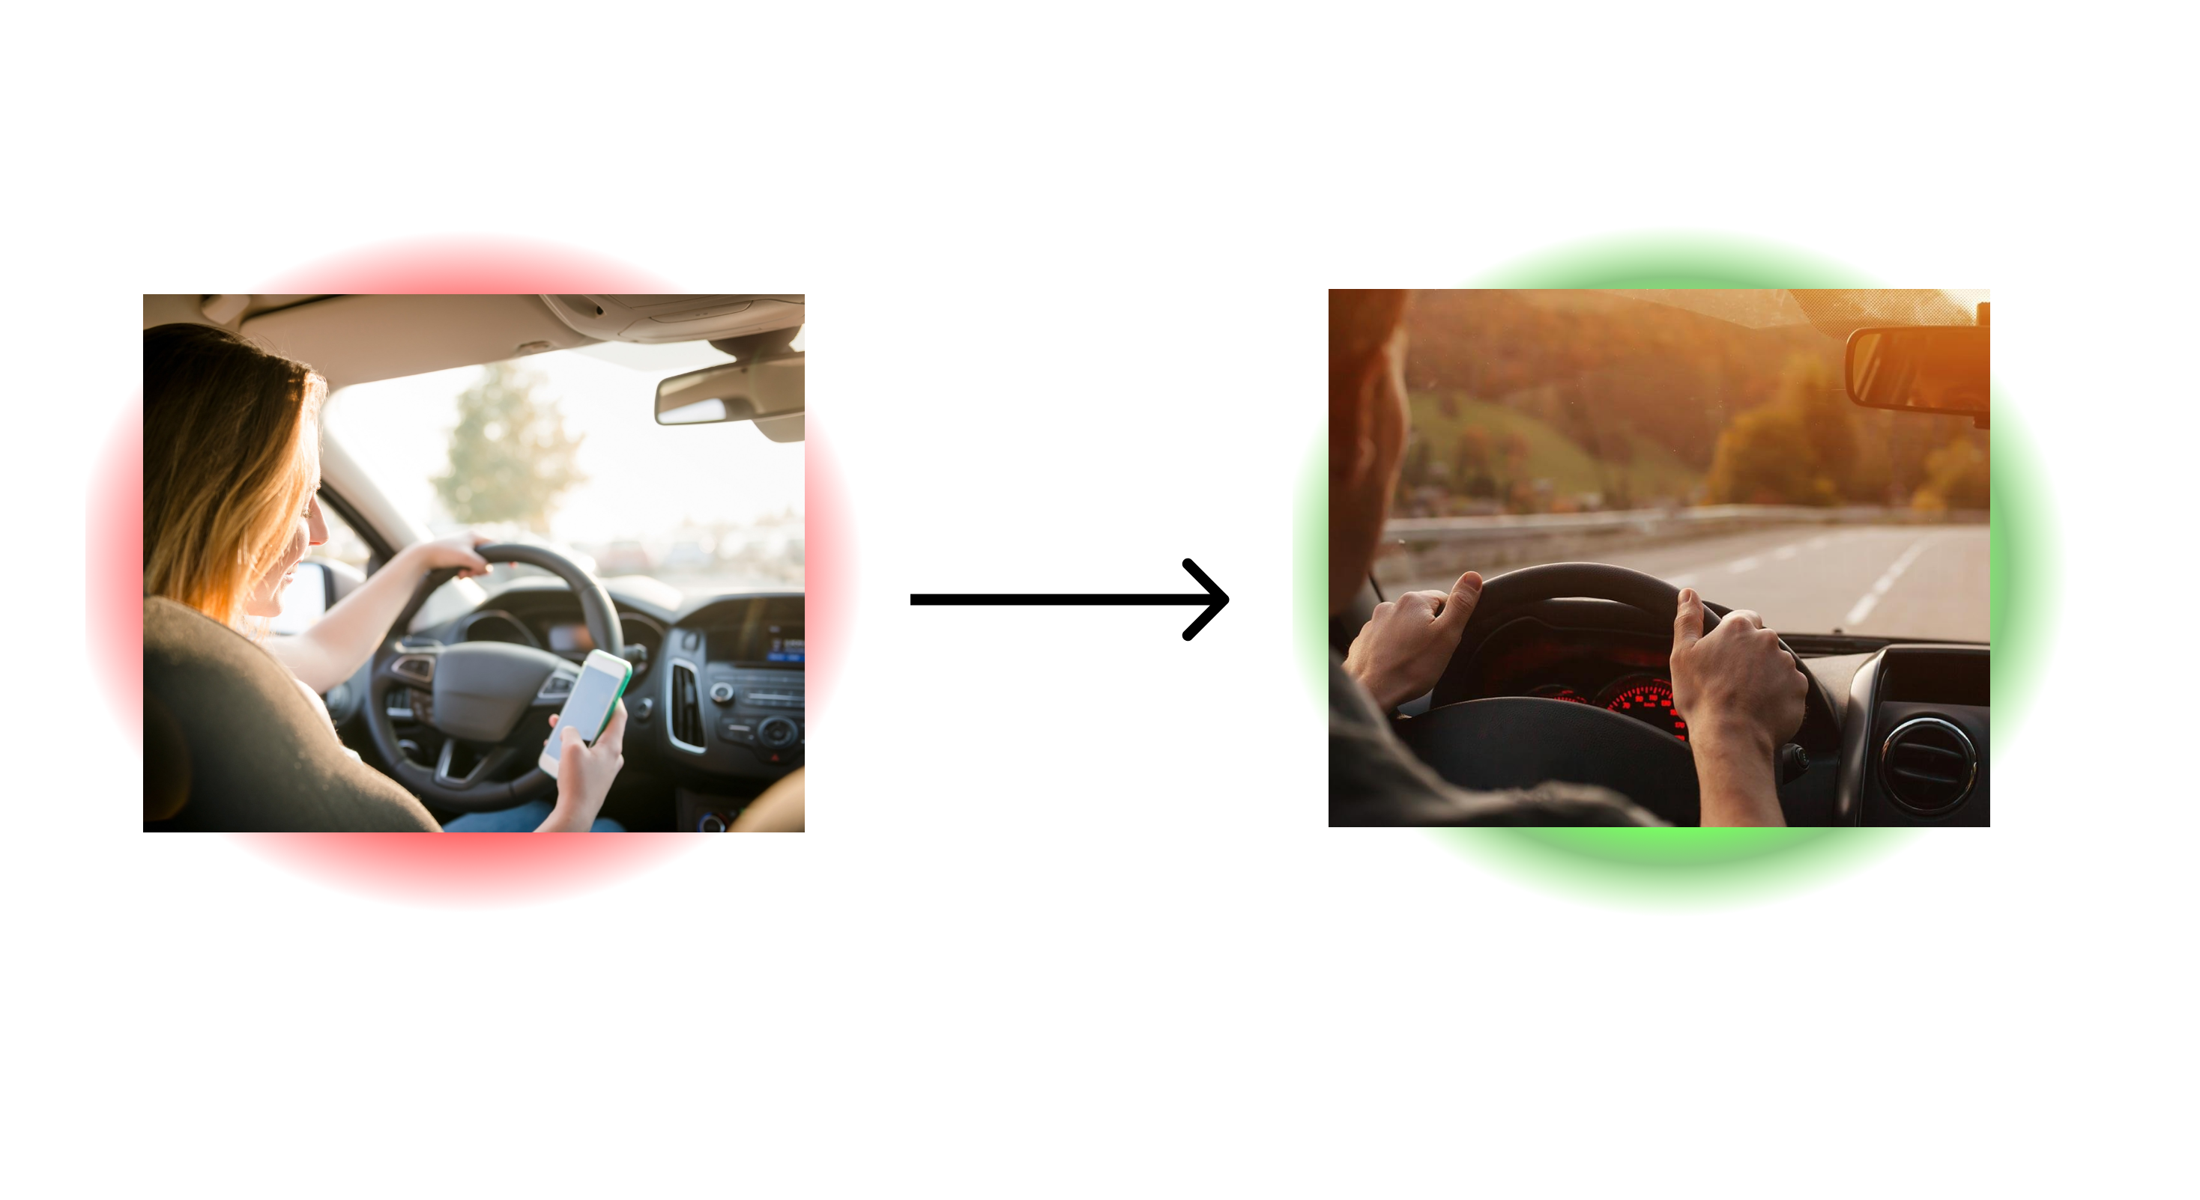
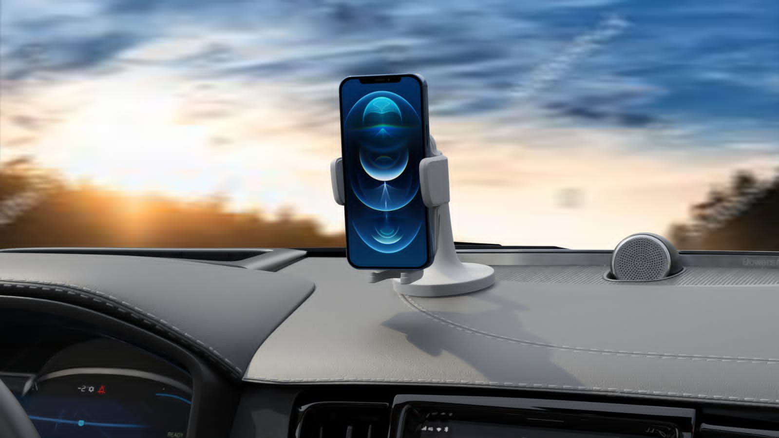




Team Name: PhoneBelt
Date: 08/09/23
Business Thesis:
We provide driver monitoring and insights for parents of new drivers
James Coleman
 | Interview count
Since last meeting | 14 | 10 | 4
Total | 17 | 11 | 6 | 0

Slide 2
Hypothesis tested:
Parent’s care about a solution to get their teen to drive safer
Parent’s care about being in control of data versus insurers having it
Questions we asked to test the hypothesis:
What are some of your biggest concerns as a parent?
What are your biggest safety concerns with your teen?
Do you track your teen’s driving today? Why? How?
Are they a good or bad driver? How did you come to that conclusion? What do they excel at and what do they need work on?
What concerns do you have with drive tracking products? What could they do better? How do you want your data protected?
How did your teen learn to drive? Tell me about that story.
Who we interviewed:
Patricia Martinez Parent
Jenn Nellinger Parent
Chris Nellinger Parent
Ryan Wilson Parent
Emily Mitchell Parent
Michael Harris Parent
Lisa Robinson Parent
Chris Tucker Parent
Jared Ponciano Parent
James Patterson Parent
Scott Taylor Parent
Andrew Lambert Parent
Janet Stuhr Parent
Tom Stuhr Parent
Martha Ito Parent
Jan Jue Parent

Slide 3
What we heard:
A lot of parents do not think their kid is the problem and that their kid is safe
Data privacy is a concern
Many people do not trust insurers with their driving data. They do not have their best interests at heart. They have not incentive to make less money by passing out discounts. Discounts not big. Insurers will sometimes charge more.
What we learned:
Everyone else is the problem on the road
Car insurance companies are extremely not trusted
Data privacy is important

Slide 4
Next steps:
Find what triggers would genuinely inspire someone to download an app. Driver insights does not appear to be a strong enough push factor.
Consider restructuring questions to find keyword triggers
See how parents respond to app form factor, IOT form factor, or both
Still talk to people outside of customer segment to understand broader market especially insurance and fleet owners

Slide 5




Business Model Canvas
Designed for: CREA
Designed by: James Coleman
Date: 08/07/23
Version: 3
Key Partners Driving schools Gov agencies that promote safe driving or involved with driving at all (DMV) Distracted driving related charities, foundations and non-profits School districts hosting distracted driving awareness week/ red ribbon week & districts that allow students to purchase on-site parking passes Community safe driving advocates. Government officials Occupational safety organizations/ government arms Parenting social media platforms and their moderators Existing indirect competitors or companies in this space that are willing to collaborate in mutually beneficial ways Who will help you? | Key Activities Build product Talk to customers Find and apply to grants Add cofounders/ employees How do you doit? | Value Propositions We provide parents the feelings of child protection while they are not physically with their teen Reduce the time parents spend time calling to check on their teen Allow parent to allocate their time and parenting to their teens that need additional help behind the wheel The peace of mind knowing their child has the tools to improve their safety behind the wheel We provide parents relief by allowing them to visualize their teen’s improvement What do you do? |  | Customer Relationships Hands off onboarding at scale Continual support through the app and the ability to talk to a rep Incentives to share the app with their friends and social media How do you interact? | Customer Segments Parents of teenage drivers, especially those using existing solutions like Life360 Who do you help?
 | Key Resources App developers Cash for building team Insurtech conference/ accelerators/ connections (industry and legal knowledge) Contract Manufacturer for hardware What do you need? |  |  | Channels Earned media (novel and controversial product) Social media marketing (working with bloggers, vloggers, reviewers, as well as our own content) Kickstarter Driving sales/ attention with driving schools and other partners Ad campaign aimed at life360 users Friend Referrals How do you reach them?
Cost Structure Hardware Costs COGS (landed) - $15 SG&A – $10 Certification costs (12k) App costs Cloud computing and storage costs (Storage, Inbound, Outbound, Compute per gig TBD) What will it cost? |  |  | Revenue Streams Freemium subscription model {free, silver, gold} Ex: $10 MRR per customer How much will you make?
Notes:
HANDOUT 1: BMC

